Slide 1
Categorizing YouTube Videos
Nitesh Gupta
Tanmay Gore

Slide 2
Why Cluster Youtube Videos?
Benefits:
Monetary Benefits
Video Recommendation
Why Clustering:
Video Categories might not be known beforehand.
Can consider metadata for classification

Slide 3
TFIDF
Data Set contains following features:
Title
Tags
Description
Converts text to numbers
Prioritizes meaningful information over stop words
Result – 50,000 dimensions

Slide 4
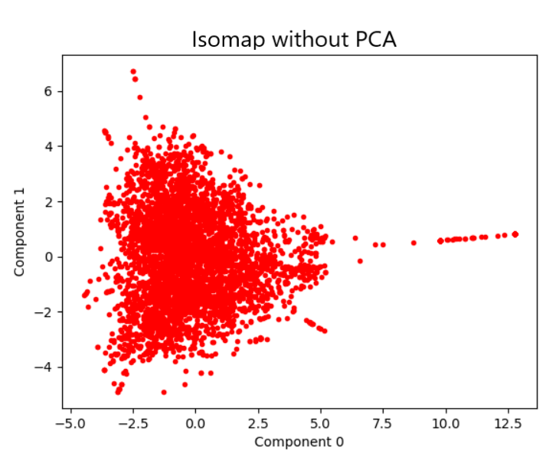
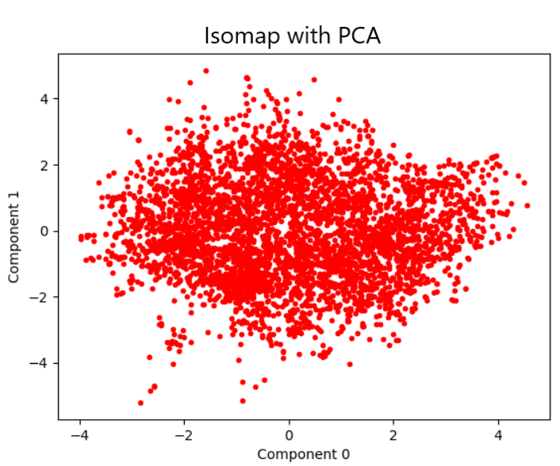
PCA
Dimensionality Reduction
Reduces 50, 000 dimensions to 3000 with only 5% loss of information.

Slide 5
KMeans
Centroid based clustering

Slide 6
Performance Measure

Slide 7
Agglomerative Hierarchical Clustering

Slide 8
Isomap

